Slide 1
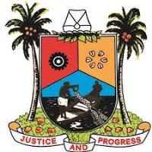
DATA PRIVACY FOR A SECURED SUSTAINABLE NATIONAL DEVELOPMENT: FOCUS ON THE GRASSROOT
TOKUNBO SMITH FIIM, FITAD, FICM, CDPSE
Managing Consultant
T&Y Information Management Services Limited

Slide 2
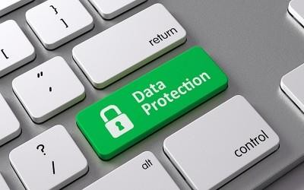
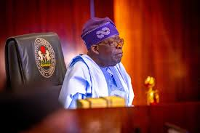
Introduction
In the modern world, almost everything there is to know about us is available online. Our medical records, our education and work history, our family connections, are very likely to be digitally stored somewhere.
Essentially, everything that we do on the internet requires sending and receiving data. For example, when you make a search on Google you send your data (the search terms, as well as your location, device) and receive Google’s data (the list of search results).
President Tinubu signed the Nigeria Data Protection Act into law on June 12, 2023.
The applicability of the Act is more focused on data controllers and processors and not data subjects which places a higher burden on Data controllers to safeguard privacy rights.

Slide 3
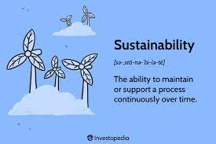

Slide 4
Organizations or movements, people or society at a local level rather than at the centre of major political activity. Local, or person‐to‐person.
GRASSROOT

Slide 5
By connecting data-driven objectives at grassroots to our goals, we can make more informed, effective, and strategic decisions, and achieve better results and outcomes. Data-driven objectives help us align our actions with our desired outcomes, and track our progress and performance.
How do data help focus goals and objectives?

Slide 6
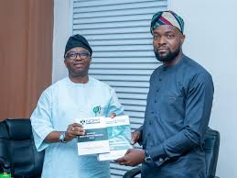
SCOPE
This Act applies to the processing of personal data whether by automated means or not
This Act applies only where—
(a) the data controller or data processor is domiciled, ordinarily resident, or ordinarily operating in Nigeria;
(b) the processing of personal data occurs within Nigeria; or
(c) the data controller or the data processor is not domiciled, ordinarily resident or ordinarily operating in Nigeria, but is processing personal data of a data subject in Nigeria.

Slide 7
BENEFITS OF DATA PROTECTION COMPLIANCE
Individuals have control over their personal data
Improved trust and confidence by clients, staff and stakeholders
Protect Individual personal data from abuse or misuse
Provide legal remedy for individuals who suffer harm or
loss from violations and data breaches either by individuals,
organizations or government
Provision of jobs in data protection and related careers
Competitive international trade from implementing global
best practices
Increase in GDP from improved international trade
Instill discipline in the use of personal data, especially
on social media and digital platforms.

Slide 8
IMPORTANCE OF PRIVACY
Preserving the trust of citizens in the sharing and utilization of personal data
Mitigating the risk of legal, financial, damaged reputation, loss of business, loss of integrity, and ethical consequences from breaches of privacy
Encourage compliance with privacy laws and regulations
Enhances disciplinary action for citizens

Slide 9
Typical Stakeholders of Data Protection Act
Consent
Data Protection Officer
A person appointed by the Data Controller responsible for overseeing data protection practices
A public institution monitoring the implementation of the regulations
Data Authority
Data Controller
The organization that controls, reviews, compares or aggregates data about their customers
Personal Data
Any information relating to an identified or identifiable natural person
Data Subject
The individual whom the particular personal data is about. Every person is considered a Data Subject: Citizens, employees, etc.
Data Processor
Processes personal data only on behalf of the controller.
Usually a third party external to the company

Slide 10
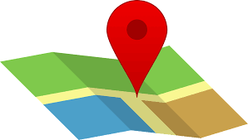
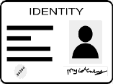
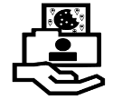
Types of Data under Protection
Personal Data
Sensitive Personal Data
Name
Health data
Biometric/Genetic data
Location
Identification Numbers
Race/Ethnicity
IP Address
Content Here
Political Opinion
Sexual orientation
Cookies

Slide 11
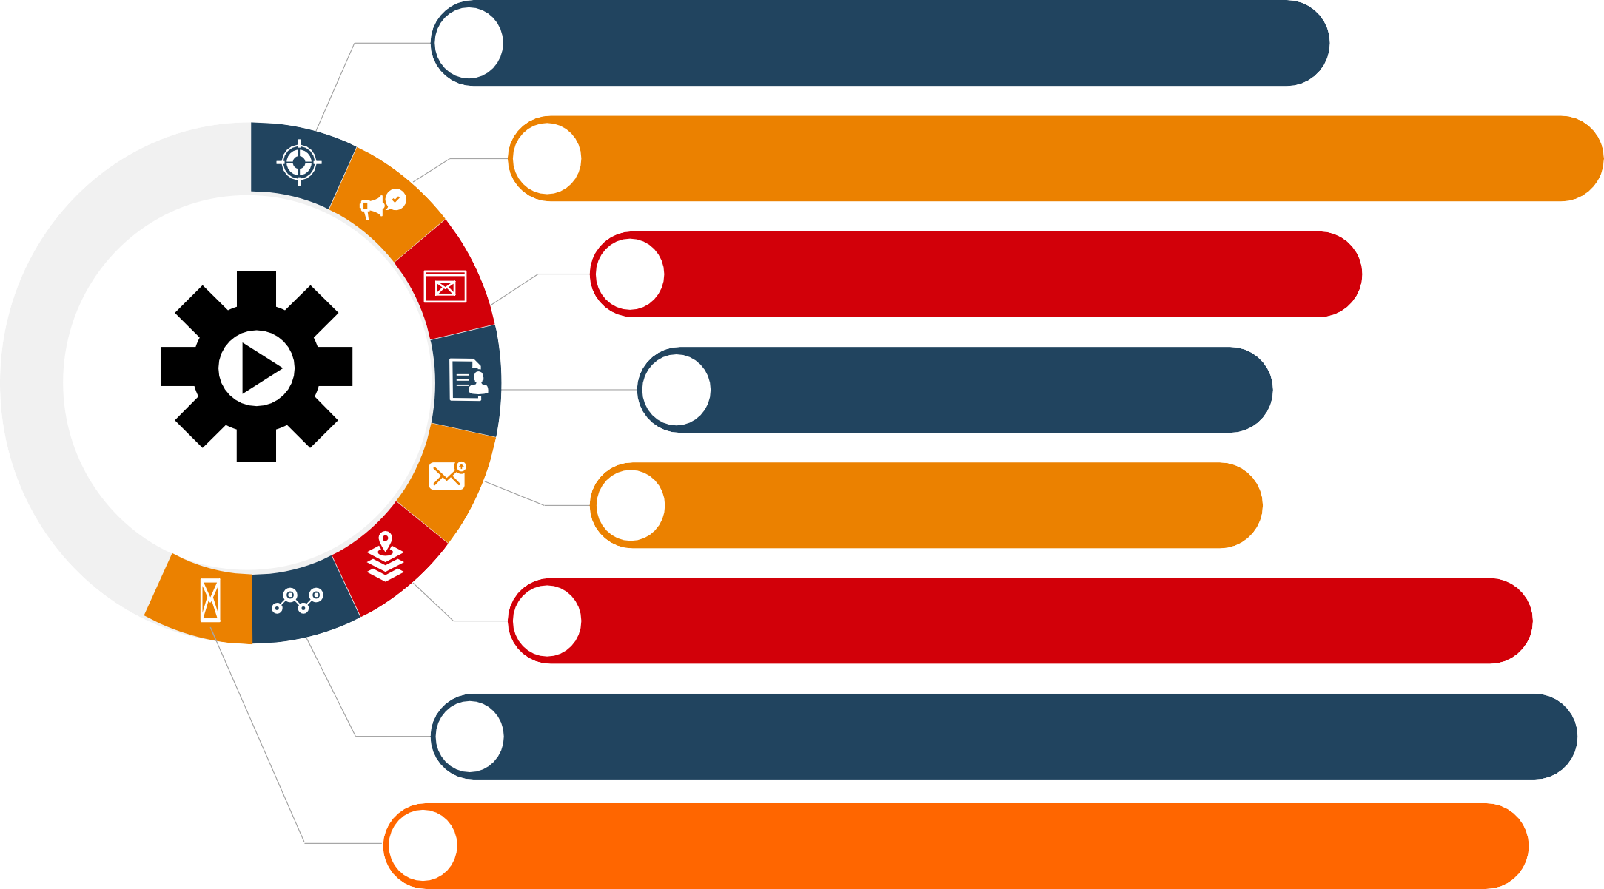
Principles of Processing Data
01
be collected and processed fairly and lawfully
02
be collected and used only for specified and lawful purpose
be adequate, relevant and not excessive
03
be kept accurate and up-to-date
04
not be kept longer than necessary
Data must
05
be processed in accordance with the rights of subjects
06
be kept secure against unauthorized processing, damage or loss
07
not be transferred outside Nigeria unless protection is adequate
08

Slide 12
Sanctions for Non-Compliance
1% of annual gross revenue of the preceding year or N2,000,000 whichever is greater depending on the number of data subjects.
2% or N10,000,000 (Ten Million Naira), whichever is greater depending on the number of data subjects.

Slide 13
Conclusion
The expectation of privacy from people, the legal and political issues that arise from that expectation, are why Data Privacy is such an important topic.
With that said, we should always be careful about what we share about ourselves online. Even when using email or social media sites, think about what information you post – if the worst should happen, would you want to share this with a complete stranger?

Slide 14
Thank you!

