Slide 1
SYMPOSIUM AND LOCAL TECH SHOWCASE - SALTS1.0
ADEYEMI BERO AUDITORIUM, LAGOS STATE SECRETARIAT, ALAUSA, LAGOS.
5TH SEPTEMBER, 2023.

Slide 2
LOCAL GOVERNMENTS AS SOURCES OF RELIABLE DATA FOR SUSTAINABLE NATIONAL DEVELOPMENT; ROLES OF TECHNOLOGY.
BY
ABDULFATTAH ODUSANYA FNCS, MCPN

Slide 3
OUTLINE
Preamble
Tiers Of Government
Local Government As Key Source Of Data
The Power Of Data
Importance Of Reliable Data For Sustainable National Development
Data Collection Activities Conducted By The Local Governments
Limitations And Inefficiencies Of Traditional Data Collection.
How Technology Can Revolutionize Data Collection And Analytics
Challenges In The Adoption Of Technology At The Local Govts Level
Strategies To Overcome The Challenges In The Full Adoption Of Technology At The Local Govts
Cross road
Conclusion

Slide 4
Preamble
In an era characterized by rapid technological advancements and a growing emphasis on data-driven decision-making, the role of Local Governments cannot be overstated. These local administrative bodies serve as the backbone of our nation's development, playing a pivotal role in collecting, managing, and disseminating reliable data that forms the bedrock for informed policy formulation and effective governance.

Slide 5
THE THREE TIERS OF GOVERNMENT.

Slide 6
LOCAL GOVERNMENT AS KEY SOURCE OF DATA.
Local government is the lowest tier in the government structure.
There are 774 Local Government Areas (LGAs) in Nigeria each administered by a Local Government Council. They all vary in character and size.
Every LGA is further divided into wards and are responsible for small local matters such as public health, waste disposal, local roads and footpaths, parks, libraries, tax collection and so on. There are 8,809 wards in all LGAs.

Slide 7
LOCAL GOVERNMENT AS KEY SOURCE OF DATA (CONT’D).
Proximity to Communities: Local governments are situated closest to the communities they serve. This proximity allows them to collect data that accurately reflects the needs, challenges, and dynamics of their specific regions.
Granular and Contextual Data: Local governments gather data at the grassroots level, capturing intricate details that may be overlooked at a national scale. This granular and contextual data provides a comprehensive understanding of local issues and trends.
Timeliness of Data: Being on the ground, local governments collect data in a more timely manner. This ensures that decision-makers receive up-to-date information for responsive policy formulation and implementation.
Cultural and Linguistic Insights: Local governments possess cultural and linguistic insights that are essential for accurate data collection. They can communicate with residents in familiar languages, facilitating better information exchange.

Slide 8
LOCAL GOVERNMENT AS KEY SOURCE OF DATA (CONT’D)
Community Engagement: Local governments engage with residents directly, involving them in data collection processes. This fosters community participation and empowers citizens to contribute to the development agenda.
Evidence for Advocacy: Local governments use data to advocate for resources and support from higher levels of government. Solid data helps make a case for funding and investments that align with local needs.
Data Trustworthiness: Locally sourced data enhance credibility and trust among citizens. People are more likely to believe and support policies backed by data collected from their own communities and so on.

Slide 9
THE POWER OF DATA
Data is often referred to as the new oil, and rightfully so. In our quest for sustainable development, accurate and timely data is the lifeblood that fuels progress. Local Governments, being in direct proximity to the communities they serve, possess a unique advantage in gathering granular data that reflects the ground realities and aspirations of our citizens. From demographic statistics to socio-economic indicators, from infrastructure utilization to environmental trends, the data generated at the local level offers unparalleled insights into the multifaceted challenges and opportunities that shape our national landscape.

Slide 10
IMPORTANCE OF RELIABLE DATA for sustainable national development.
Informed Decision-Making: Accurate data provides policymakers with a clear understanding of current socio-economic conditions, enabling them to make well-informed decisions.
Resource Allocation: Accurate data guides resource allocation by revealing areas that require investment or support. This prevents wastage and ensures that resources are channeled to where they are most needed.
Measuring Progress: Data serves as a yardstick to measure the success of development initiatives. It enables tracking of progress over time, facilitating adjustments to strategies and goals as needed, and ensuring that the nation is on the path to sustainable growth.

Slide 11
IMPORTANCE OF RELIABLE DATA for sustainable national development (cont’d).
Targeted Interventions: Reliable data helps identify vulnerable populations, regions, or sectors requiring special attention. This allows for the design of targeted interventions that address specific issues, reducing disparities and fostering equitable development.
Attracting Investments: Investors seek reliable data to assess the viability of potential investments. Quality data enhances a country's credibility, attracting both domestic and foreign investments that fuels economic growth.
Transparency and Accountability: Accessible data fosters transparency in governance, holding public officials accountable for their actions and decisions. Citizens can actively engage in public discourse, advocating for policies aligned with their needs.
Long-Term Planning: Data-driven insights support long-term planning by identifying trends and predicting future challenges. This helps nations prepare for emerging issues and ensures a stable and resilient developmental trajectory.

Slide 12
IMPORTANCE OF RELIABLE DATA for sustainable national development (cont’d).
In essence, reliable data serves as a compass, guiding a nation towards sustainable development by empowering governments, citizens, and stakeholders with accurate information, fostering inclusive growth, poverty reduction, and improved quality of life for all.

Slide 13
DATA COLLECTION ACTIVITIES CONDUCTED BY THE LOCAL GOVERNMENTS.
Demographic Surveys: Local governments conduct demographic surveys to gather information about the size, composition, and characteristics of their communities. This data is crucial for planning public services, infrastructure, and social programs.
Vital Statistics Collection: Recording births, deaths, marriages, and other vital events helps local governments track population trends, assess healthcare needs, and plan for social services.
Health and Sanitation Data: Collecting health-related data, such as disease prevalence, vaccination rates, and access to healthcare facilities, allows local governments to address public health challenges and improve healthcare services.
Agricultural and Rural Data: Gathering data on agricultural activities, land use, and rural development supports agricultural planning and rural growth strategies.

Slide 14
DATA COLLECTION ACTIVITIES CONDUCTED BY THE LOCAL GOVERNMENTS (CONT’D).
Cultural and Heritage Data: Documenting cultural heritage sites, traditions, and local arts contributes to the preservation of cultural identity and heritage.
Community Engagement Surveys: Conducting surveys to gauge public opinion and gather feedback on local and other tiers of government policies and services helps improve governance and responsiveness.
Social Services and Welfare: Gathering data on social assistance programs, vulnerable populations, and social service utilization helps local governments allocate resources to support those in need.
Educational Data: Local governments gather data on school enrollment, out-of-school rates, literacy levels, and educational facilities. This information guides education policies and ensures access to quality education and so on.

Slide 15
LIMITATIONS AND INEFFICIENCIES OF TRADITIONAL DATA COLLECTION.
Time-Consuming: Traditional methods often involve manual data entry and processing, which can be time-consuming and labour-intensive. This can lead to delays in obtaining and analyzing the data.
Limited Scope: Traditional methods may only capture a limited scope of information due to the constraints of paper-based surveys or in-person interviews. This can result in incomplete or narrow datasets.
High Costs: Printing, distributing, and processing paper surveys can incur high costs, especially when dealing with large populations or extensive geographic areas.
Human Error: Manual data entry is susceptible to errors such as typographical mistakes, misinterpretations, and data transcription errors. These errors can lead to inaccurate or unreliable data.
Scalability: Traditional methods may not be easily scalable to accommodate larger populations or to collect data across expansive geographic areas.

Slide 17
LIMITATIONS AND INEFFICIENCIES OF TRADITIONAL DATA COLLECTION (CONT’D).
Subjective Interpretation: Responses collected through interviews or open-ended surveys may be subject to interpretation by data collectors, leading to potential bias and inconsistency.
Data Security and Storage: Storing and securing paper-based data can be vulnerable to loss, damage, or unauthorized access, compromising data integrity and privacy.
Lack of Real-Time Updates: Traditional methods often lack the ability to provide real-time updates on changing conditions or events, limiting their usefulness for timely decision-making.
Geographic Constraints: In-person data collection methods may be impractical or costly in remote or hard-to-reach areas, resulting in uneven data coverage.
Survey Fatigue: Respondents may experience survey fatigue or may be less likely to participate in lengthy or repetitive data collection processes and so on.

Slide 18
HOW TECHNOLOGY CAN REVOLUTIONIZE DATA COLLECTION AND ANALYTICS.
Addressing the inefficiencies of traditional data collection and analysis requires a shift towards emerging trends in technology, which can mitigate delays, improve accuracy, reduce resource demands, and enhance data collection and analytics. And they are as follows:
Online Survey Software and Tools: e.g. Google Form, JetForm, Survey Monkey, TypeForm, SurveyPlanet, PaperForm, Feedier, Hub Spot, etc.
- Online survey platforms and mobile apps enable the creation and distribution of digital surveys and forms through mobile devices.

Slide 19
HOW TECHNOLOGY CAN REVOLUTIONIZE DATA COLLECTION AND ANALYTICS (CONT’D).
Geographic Information Systems (GIS): It enables decision-makers to understand how data varies across geographical areas, facilitating informed resource allocation and policy formulation.
Cloud Storage and Collaboration: Cloud platforms facilitate secure storage and sharing of data among multiple stakeholders, allowing for seamless collaboration and access to data from anywhere.
Machine Learning and AI: Advanced analytics, machine learning, and AI can process large datasets to uncover insights and trends that might be missed using manual methods.

Slide 20
HOW TECHNOLOGY CAN REVOLUTIONIZE DATA COLLECTION PROCESSES (CONT’D).
Internet of Things (IoT) Devices: IoT devices are particularly valuable in remote or inaccessible locations where continuous data collection is essential.
- They contribute to data-driven decision-making by providing up-to-date and accurate information without human intervention.

Slide 21
CHALLENGES IN THE ADOPTION OF TECHNOLOGY AT THE LOCAL GOVT LEVEL.
Digital Divide: The digital divide refers to the gap in access to and use of technology between different groups or communities. Not everyone has equal access to smartphones, computers, or the internet.
Lack of Technical Skills: Collecting, analyzing, and interpreting digital data requires technical skills. Many individuals, particularly in remote or underserved areas, may lack the necessary skills to use digital tools effectively.

Slide 22
CHALLENGES IN THE ADOPTION OF TECHNOLOGY (CONT’D).
Privacy and Data Security Concerns: Collecting and storing digital data raises concerns about privacy and data security. People may be hesitant to share personal information digitally due to fears of data breaches or misuse.
Lack of Political Will and Legal Framework: Political leaders and administrators lack the wherewithal to enforce the use and adoption of technology at the Local Government level.
Also, legal framework are virtually not in place for technology to permeate the Local Government administration.

Slide 23
CHALLENGES IN THE ADOPTION OF TECHNOLOGY (CONT’D).
Cultural and Linguistic Barriers: Digital tools and platforms may not be available in local languages or may not be culturally appropriate for certain communities.
Cost Considerations: Implementing technology-based initiatives requires investments in hardware, software, training, and maintenance. Limited budgets or financial constraints can hinder the adoption of technology, particularly in resource-constrained environments.
Hijack by non Professionals: mainly due to the perceived notion of juicy budget of IT Departments or IT projects.

Slide 24
CHALLENGES IN THE ADOPTION OF TECHNOLOGY (CONT’D).
Poor Establishment Structure for the IT Cadre in the Local Government Service: Local Governments do not have directorates for the IT Cadre.
Dearth of Seasoned IT Professionals in the Local Government Service: due to poor remuneration and atrocious working condition.

Slide 25
Strategies to overcome THE CHALLENGES IN THE FULL ADOPTION OF TECHNOLOGY AT THE LOCAL GOVTS.
Public-Private Partnerships: Collaborate with private sector entities to provide access to technology resources, such as devices, internet connectivity, and technical expertise. Leverage corporate social responsibility initiatives to support capacity-building efforts and bridge the digital divide.
Digital Literacy and Skills Training: Develop training programs that focus on building digital literacy and technical skills among local government officials, community leaders, and citizens.

Slide 26
Strategies to overcome THE CHALLENGES IN THE FULL ADOPTION OF TECHNOLOGY AT THE LOCAL GOVTS (CONT’D).
Train the Trainers: Empower IT professionals and other LG officials, with emerging IT skills for them to play a vital role in imparting requisite knowledge and promote digital literacy, assisting with data collection, mining, analytics and providing technical support.
Tailored Solutions for Accessibility: Develop user-friendly, localized, and culturally relevant digital tools and platforms that cater for diverse populations and language preferences.
- Ensure that technology solutions are accessible to individuals with disabilities, taking into consideration their unique needs.

Slide 27
Strategies to overcome THE CHALLENGES IN THE FULL ADOPTION OF TECHNOLOGY AT THE LOCAL GOVTS (CONT’D).
Multi-Stakeholder Collaborations: Establish partnerships between government agencies, non-governmental organizations, academic institutions, and financial institutions to pool resources and expertise. These collaborative efforts can facilitate the design, implementation, and evaluation of technology-driven data collection projects.
Sustainable Funding Models: Develop sustainable funding models that allocate resources for ongoing capacity-building, training, and technology maintenance.
- Seek grants, partnerships, and allocate a yearly percentage of the Local Govt budget backed by law to support technology adoption and skill development.

Slide 28
CROSS ROAD: Reliable Grassroots’ Data to the Rescue
The Nation is at cross road, due to inadequate data and social register, palliative distribution to the poor and vulnerable population is perceived fraudulent, ineffective, looks unrealizable.
Imagine a scenario where 1 to 5 IT Data Registry (depending on the population density of the wards) are situated in wards and are linked to each States’ Data Centre which will directly feed National data centric MDAs like NIMC, NPC, NIS and even INEC via secured APIs. These mini centres in each ward will be manned by IT Professionals in LGAs and other relevant Staff. The Federal MDAs will only need to deploy relatively few staff at State Capitals or at the regional level for coordination.

Slide 29
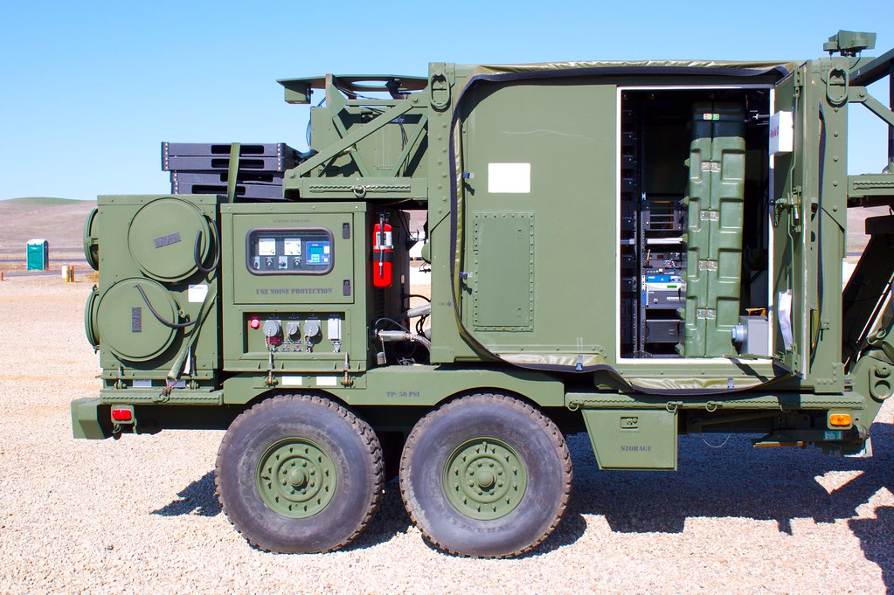
MOBILE DATA CENTRE

Slide 30
CROSS ROAD: Reliable Grassroots’ Data to the Rescue (Cont’d)
We will have put in place 8,809 x 5 = 44,045 Data Registries with state-of-the-art IT Infrastructure and unlimited broadband connection across the country. The centres can be doubled overtime with a ward having up to 10 (a total of 88,090 nationwide).
The mini centres will serve the purpose of citizens data collection on a regular basis.
Note that the States data centres will be integrated into National data bank.
The structure is on ground but we fail to utilize it. This honestly, will solve problems plaguing the nation.

Slide 31
A MEGA DATA CENTRE

Slide 32
CROSS ROAD: Reliable Grassroots’ Data to the Rescue (Cont’d)
PHCs should be equipped with broadband connection, while EMR are deployed that would have been integrated to the State Data Centres and the National Data bank.
When patients present for clinicals his/her medical records are updated upon retrieval of earlier data captured at mini centres/data registries of his or her ward at the LGA.

Slide 33
CONCLUSION
Local Governments serve as essential source of data due to their unique position as frontline agents of governance.
In closing, the nexus between Local Governments, reliable data, technology, and innovation is a nexus of boundless potential. As we explore this theme today, let us remember that each line of code written, each data collected, and each innovation embraced brings us closer to a future where our nation thrives on the principles of inclusivity, efficiency, resilience, and sustainability.
I implore each one of you, esteemed IT professionals, to embrace your roles as architects of progress, as catalysts for change. Together, we have the power to transform our Local Governments into beacons of data-driven excellence, lightening the path towards a truly sustainable and prosperous national future.

Slide 34
THANK YOU FOR LISTENING.

